Slide 1
COMP 3400
Week 10 – Friday

Slide 2
Last time
What did we talk about last time?
Exam 2 post mortem
Language approaches to threading
Practice with threads
Prime counting

Slide 3
Questions?

Slide 4
Assignment 6

Slide 5
Thread Practice

Slide 6
Concurrent prime number search
Let's write a threaded program that counts the number of primes less than 100,000,000
We'll spawn a number of threads and divide up the range of values from 0 to 100,000,000 evenly
To send data to each thread and get the result, we'll use dynamically allocated versions of the following struct:
struct range {
unsigned long start;
unsigned long end;
unsigned long count;
};

Slide 7
Algorithm
Divide the total number by the number of threads to determine how many numbers to give each thread
Loop through all threads:
Allocate a range struct to hold the lower and upper value for each thread
Create each thread
Loop through all threads:
Join them
Inside each thread:
Loop from the lower to the upper value and increment a counter if the value is prime
Store the count into the range struct
Call pthread_exit() when done

Slide 8
POSIX thread functions
As a reminder, here are the POSIX functions we need
Create a new thread (not as bad as it looks)
Exit from the current thread (giving a pointer to the result, if any)
Join a thread (getting a pointer to its result, if any)
int pthread_create (pthread_t *thread, const pthread_attr_t *attr,
void *(*start_routine)(void*), void *arg);
void pthread_exit (void *value_ptr);
void pthread_join (pthread_t thread, void *value_ptr);

Slide 9
Synchronization

Slide 10
Synchronization
Now you have all the tools needed to create, run, and join threads
But you don't have any tools to avoid the problem of race conditions
Synchronization is used to coordinate between threads, often by enforcing critical sections, sections of code that only one thread can be executing at a time
Common synchronization tools:
Locks (mutexes)
Semaphores
Barriers
Condition variables
If used incorrectly, however, synchronization tools can lead to other problems such as deadlock and livelock

Slide 11
Examples of synchronization
The following are common examples of synchronization:
Multiple threads share a data structure, but only one can write to it at a time
Only so many threads can access a shared resource to avoid slowdowns
Certain events need to happen in a certain order
Some calculations must be done before an action can be taken
Performing synchronization so that the result is correct while avoiding performance penalties is challenging

Slide 12
Critical sections
Recall that a critical section is a section of code that it's safe for only a single thread to be executing
Often this is because non-atomic memory accesses (such as reading a value, doing calculations, and then writing back to memory) can get inconsistent results if more than one thread is executing them concurrently
A common use of synchronization tools is to block threads trying to access a critical section if a thread is already executing it

Slide 13
Peterson's solution
Peterson's solution demonstrates a way to enforce a critical section for two threads
Here's the idea, where the flag array and turn are shared variables
flag[self] = true;
turn = other; // Politely assume it's the other person's turn
// Execute loop until it's safe to enter
while (flag[other] == true && turn == other) ;
// Here's where the code for the critical section goes
flag[self] = false; // Mark yourself as finished

Slide 14
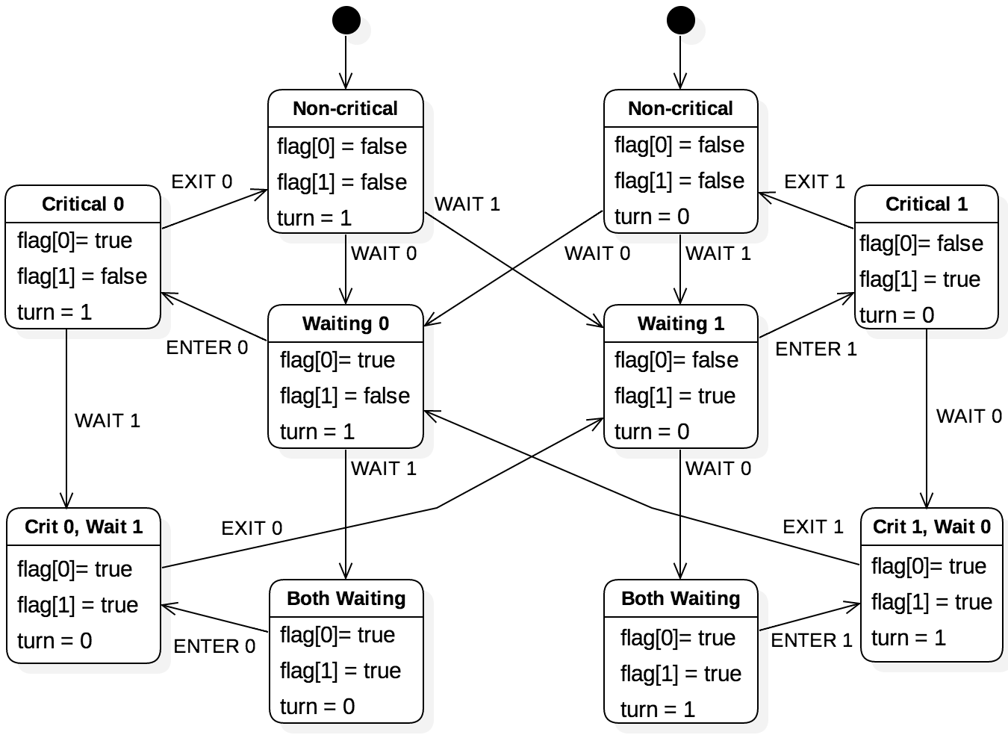
Why Peterson's solution works
This state diagram shows all the possible states the system can be in
There's no state where both 0 and 1 are in the critical section
The only changes to memory that matter are atomic writes

Slide 15
Synchronization properties
We often want three synchronization properties:
Safety: There's never more than one thread in the critical section
Also called mutual exclusion
Liveness: If no thread is in the critical section and one or more threads try to enter, one thread will be able to
Also called progress
Fairness: Assuming that no thread will stay in the critical section forever, a thread trying to get into the critical section will eventually get in
Also called bounded waiting
Peterson's solution provides all three

Slide 16
Why Peterson's solution doesn't work in general
It's only described for two threads and gets messy for more
It requires thinking about which variables to set rather than providing more general tools (like locks)
It requires busy waiting (repeatedly executing a loop)
It's not guaranteed to work on modern hardware that sometimes switches the order of instructions for better pipelining
These changes are guaranteed to work in a single-threaded context but can't take into account what other threads are doing

Slide 17
Locks

Slide 18
Locks
A key synchronization tool is called a lock (or a mutex, short for mutual exclusion)
Critical sections can be protected by a lock
First code acquires the lock
Then it performs the code in the critical section
Then it releases the lock
For POSIX threads, lock functionality is provided by several mutex functions that operate on pthread_mutex_t objects

Slide 19
Lock features
Mutual exclusion
Locks start unlocked
Only one thread can acquire a lock at a time
No other thread can acquire a lock until it's been released
Non-preemption
A lock must be voluntarily released by the thread that acquired it
Atomic operations
Acquire and release are atomic operations
Blocking acquires
If a thread tries to acquire a lock, it's blocked and added to the queue
When the thread holding the lock releases it, only one thread acquires it

Slide 20
POSIX mutex functions
int pthread_mutex_init (pthread_mutex_t *mutex,
const pthread_mutexattr_t *attr);
Create a mutex with the specified attributes
Destroy an existing mutex
Acquire a mutex, blocking until you succeed
Try to acquire a mutex, returning non-zero if another thread has the mutex
Release the mutex
int pthread_mutex_destroy (pthread_mutex_t *mutex);
int pthread_mutex_lock (pthread_mutex_t *mutex);
int pthread_mutex_trylock (pthread_mutex_t *mutex);
int pthread_mutex_unlock (pthread_mutex_t *mutex);

Slide 21
Mutex example
Here's a thread that uses a mutex when incrementing a global variable
int global = 5;
// Each increment thread gets a pointer to the mutex
void *
increment (void *args)
{
pthread_mutex_t *mutex = (pthread_mutex_t *) args;
// Lock for the critical section, then release
pthread_mutex_lock (mutex);
global++;
pthread_mutex_unlock (mutex);
pthread_exit (NULL);
}

Slide 22
Main program
The following program creates the mutex and passes it to two threads
Note that the mutex lives on the stack, but that's okay since this function won't return until after the other threads are done
pthread_t threads[2];
pthread_mutex_t mutex;
// Initialize the mutex
pthread_mutex_init (&mutex, NULL);
// Create the child threads, passing pointers to the mutex
assert (pthread_create (&threads[0], NULL, increment, &mutex) == 0);
assert (pthread_create (&threads[1], NULL, increment, &mutex) == 0);
// Join the threads
pthread_join (threads[0], NULL);
pthread_join (threads[1], NULL);
// Confirm the result
assert (global == 7);

Slide 23
Length of critical sections
The first example on the previous slide will take much longer, since it has to lock and unlock 1,000,000 times
On the other hand, the second example will block all other threads from running code that depends on the lock until it's finished
Neither is very realistic, since incrementing a variable 1,000,000 times in a loop is ridiculous
There's no simple solution: depends on the problem
Always getting the right answer is the first goal and then tuning for better performance comes second

Slide 24
Ticket Out the Door

Slide 25
Upcoming

Slide 26
Next time…
Finish locks
Semaphores

Slide 27
Reminders
Finish Assignment 6
Due tonight by midnight!
Work on Project 3
Read section 7.4

